Slide 1

“Something momentous happened around the year 2000: a major new soft technology came of age. After written language and money, software is only the third major soft technology to appear in human civilization. Fifteen years into the age of software, we are still struggling to understand exactly what has happened. Marc Andreessen’s now-familiar line, software is eating the world, hints at the significance, but we are only just beginning to figure out how to think about the world in which we find ourselves.”
A New Soft Technology
Breaking Smart
http://breakingsmart.com/season-1/a-new-soft-technology/
Notes:
Just leave this slide up for a few minutes before you start, and the audience will read it while they wait for you to begin.
https://www.youtube.com/watch?v=x0aDl4i5cdE

Slide 2
Data Science… what is it?
(a short introduction)

Slide 3
Data Science Roles
Data Scientist
Data Science Analyst
Data Science Consulting
Data Science Engineer
Data Engineer
Data Product Manager
Data Analyst
Natural Language Processing
Data Analytics Engineer
Data Aggregation Engineer
Quantitative Analyst
Operations Analyst
Machine Learning Engineer
Software Engineer
Platform Engineer
AI Research

Slide 4
Data Science in Industry

Slide 5
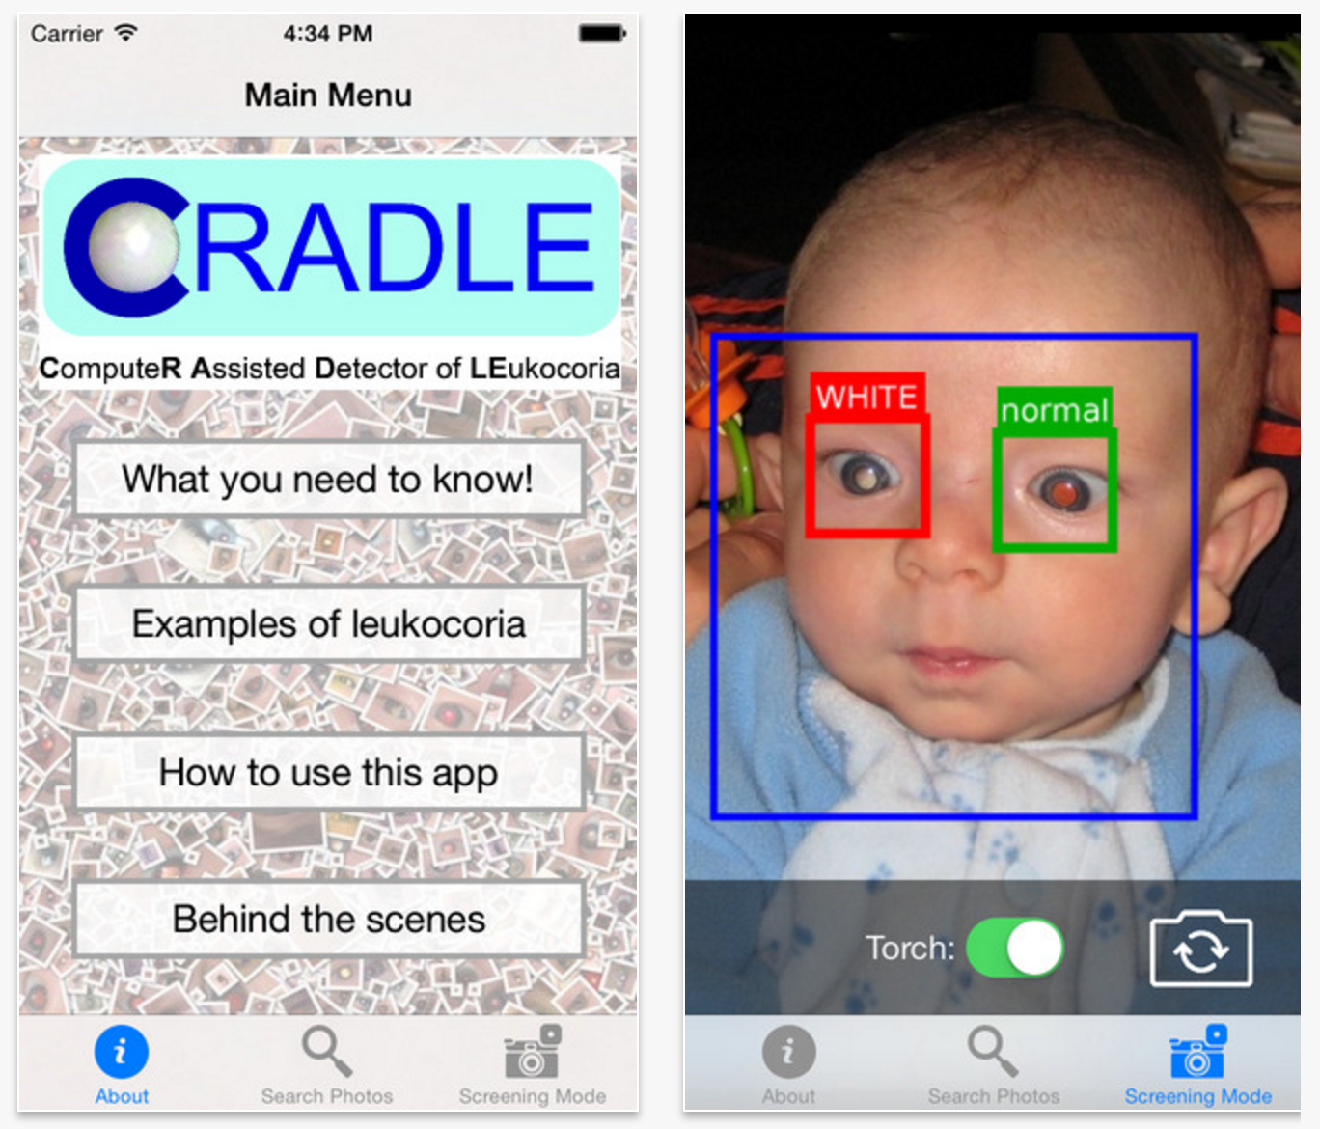
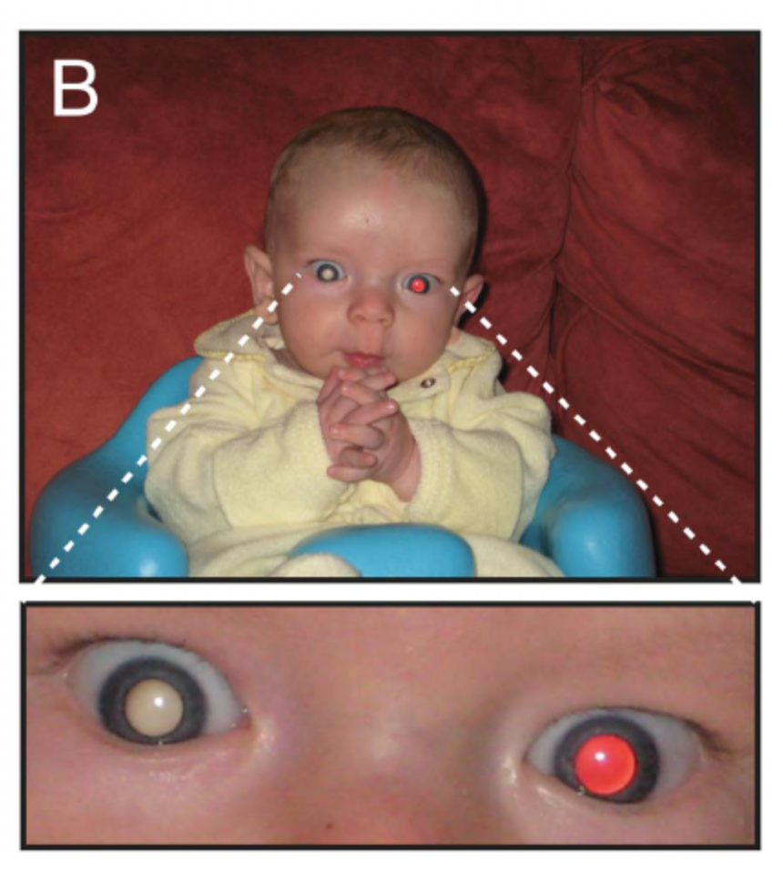
Healthcare: Build a smartphone app that detects a symptom of cancer.

Slide 6
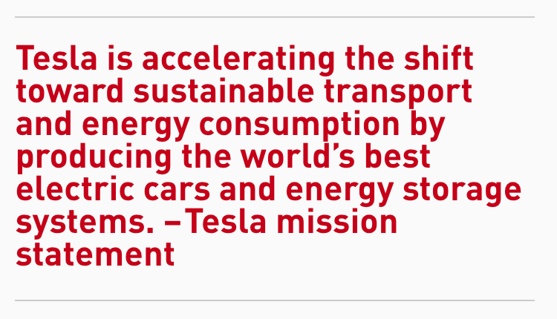
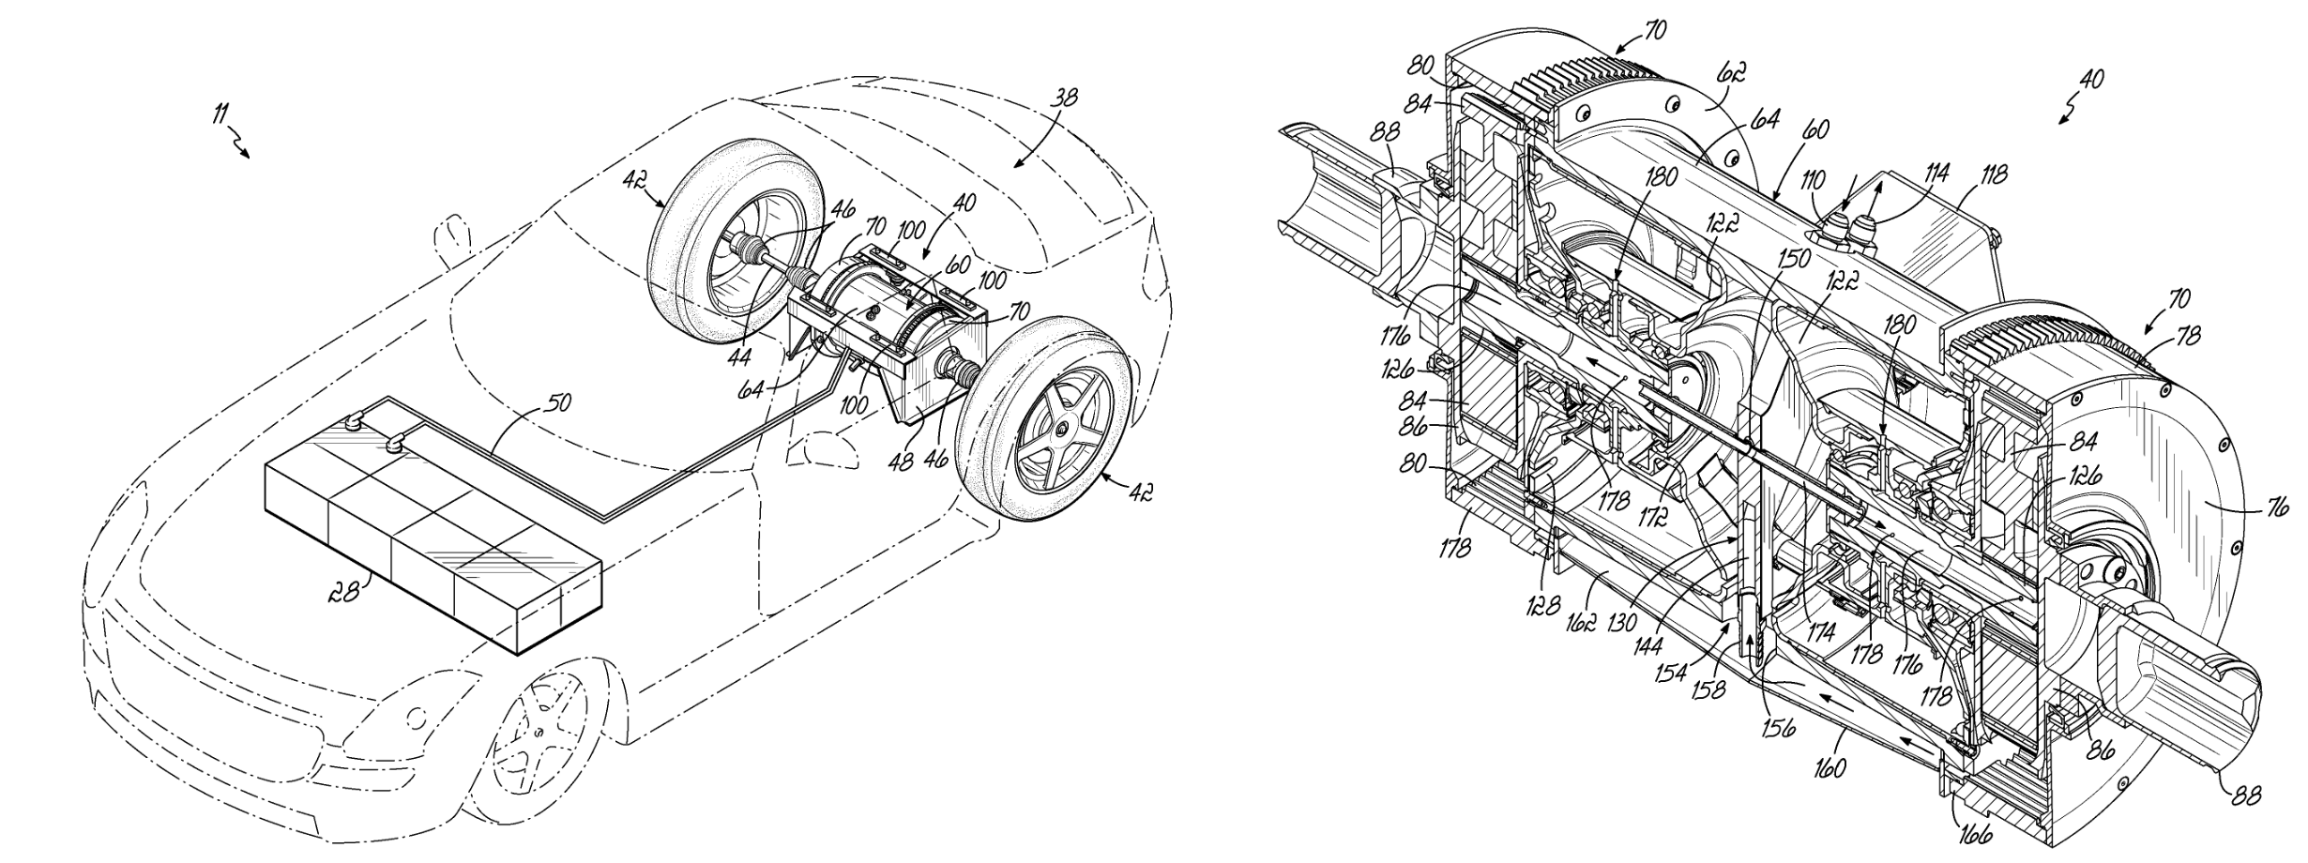
Automotive: Generate accurate
failure rate for all components in
electric vehicles.
http://recode.net/2016/04/05/we-underestimate-tesla/

Slide 7

Banking: Improve loan default prediction.
Approved
Declined

Slide 8
DSI Capstone Projects

Slide 9

Capstone Project: Furniture Seeker by Lili Yao

Slide 10

Capstone Project: Furniture Seeker

Slide 11
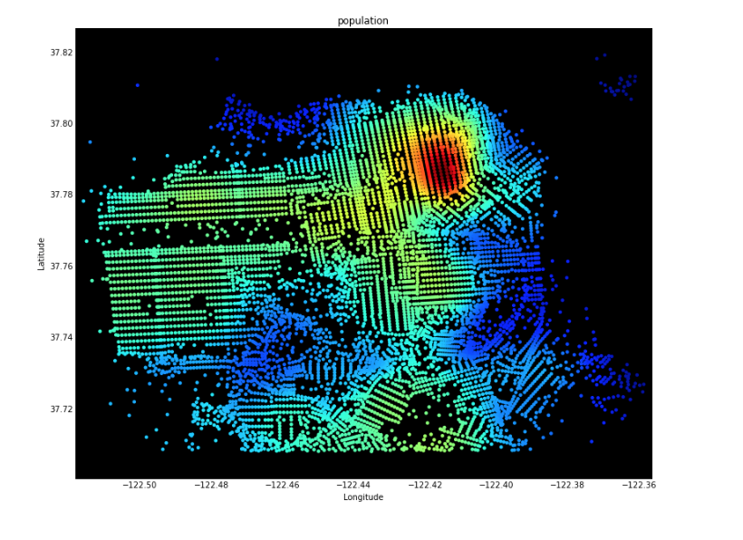
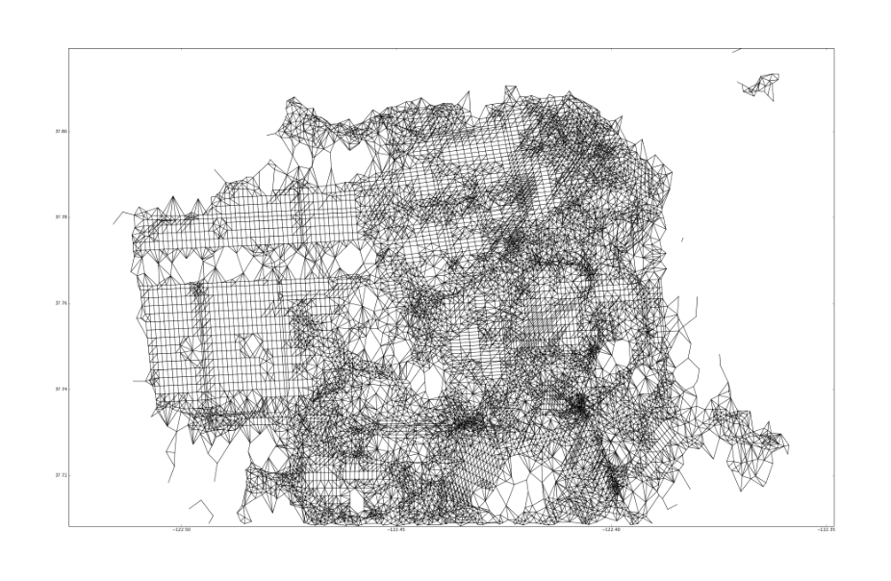
Capstone Project: hoodieSF by Chris Rupley

Slide 12
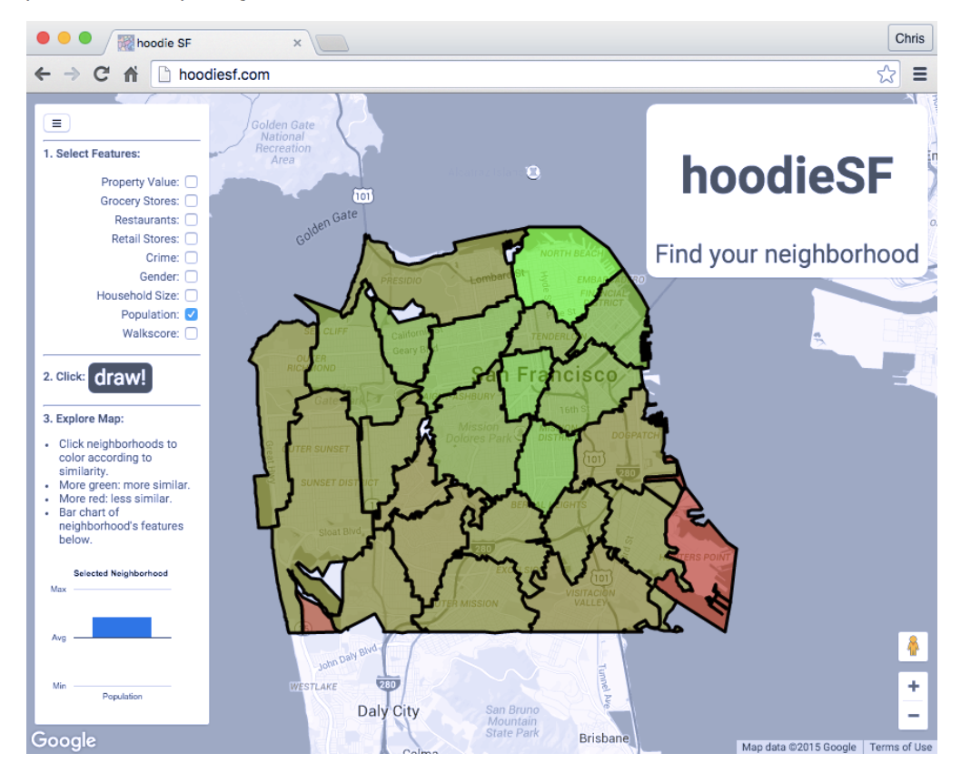
Capstone Project: hoodieSF

Slide 13
Data is King
“Information is the oil of the 21st century, and analytics is the combustion engine.”
- Peter Sondergaard, Gartner Research
http://www.gartner.com/newsroom/id/1824919

